Slide 1

Placement Management System
By
Monika Jundhare
B.E
Batch: 2020 – 5759
Center: Thane
Under the Guidance of,
Chittaranjan Ghosh
Technical Trainer
EduBridge
(School of coding)

Slide 2
INDEX:
Introduction :
Software Requirement :
Data Dictionary :
Screenshots :

Slide 3
INTRODUCTION
Our project explains about the placement Management Website .This project mainly explains the various actions related to placement. You can search various jobs and check their your status . Our Project Include
Modules:-
Admin Module Recruiter Module Student Module

Slide 4
SOFTWARE REQUIREMENTS:
Front end: Java/J2EE technologies (Servlet, JSP), HTML, CSS, JavaScript, Bootstrap, Hibernate.
Back end: MySQL workbench 8.0.23CE.
Middleware/Server: Apache Tomcat v8.5. IDE: Eclipse IDE for Java EE Developers
Browser: Best result on Google Chrome
Operating System: Window 10.

Slide 5
DATA DICTIONARY:
Create database placement
Create table admin
Create table Recruiter
Create table Student

Slide 6
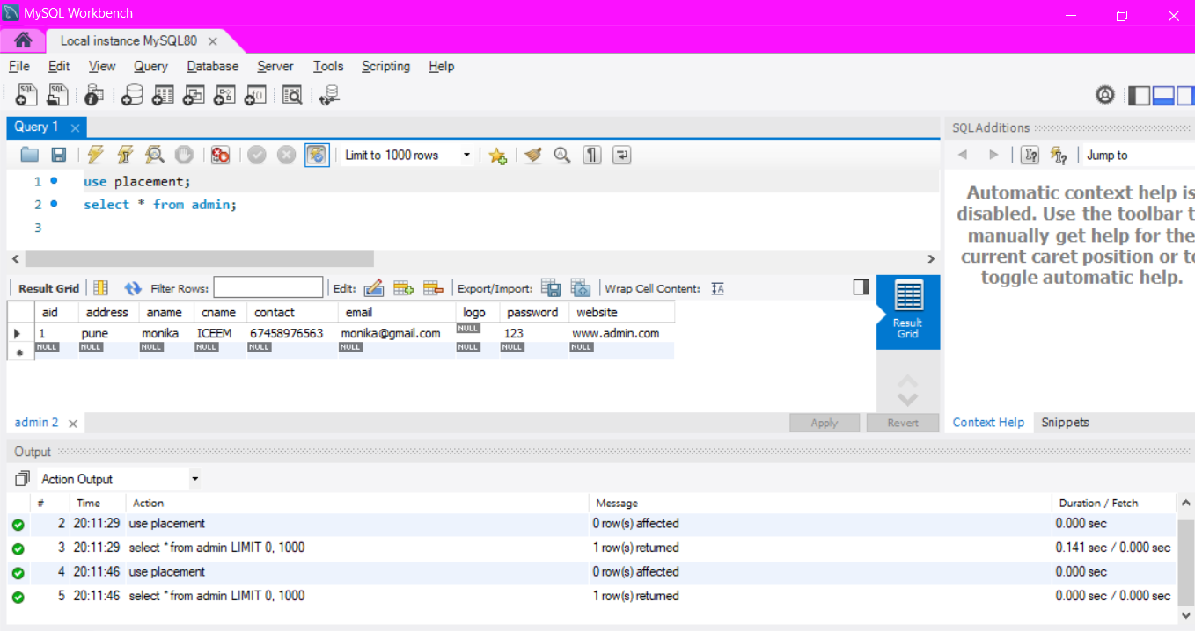
Hibernate: create table Admin

Slide 7
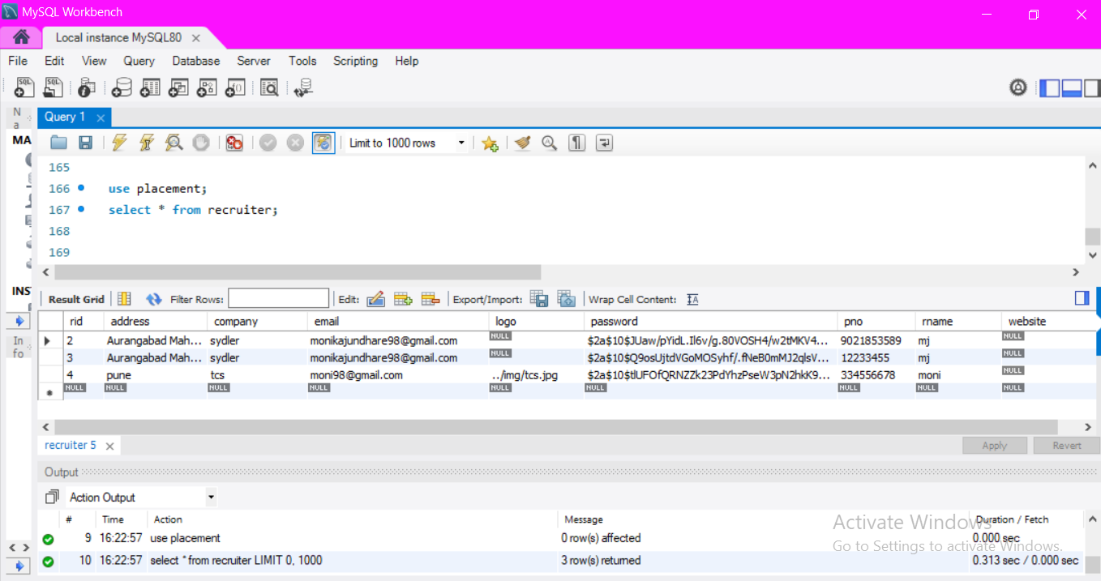
Hibernate: create table Recruiter

Slide 8
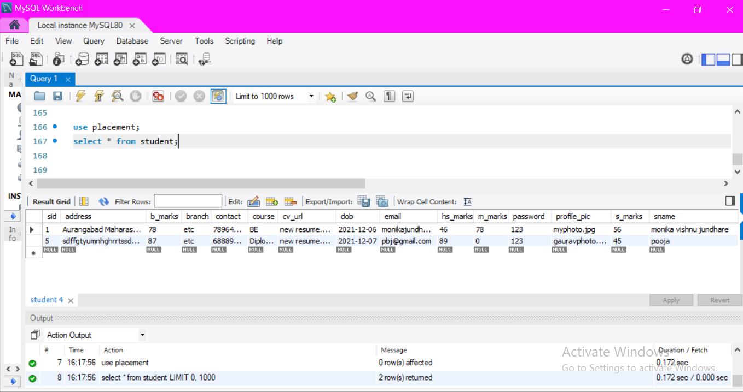
Hibernate: create table Student

Slide 9
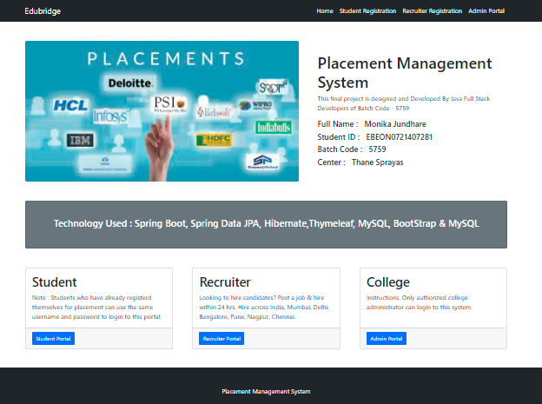
Home Page:

Slide 10
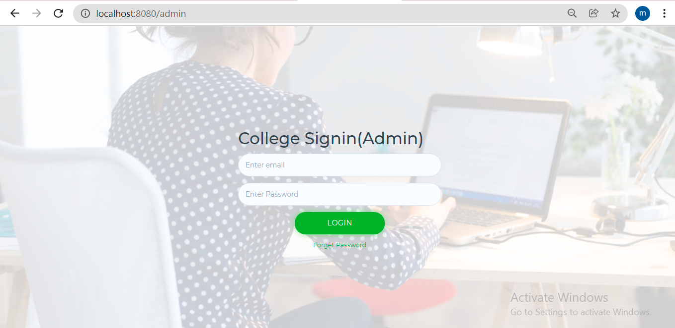
Admin Sign in page:

Slide 11
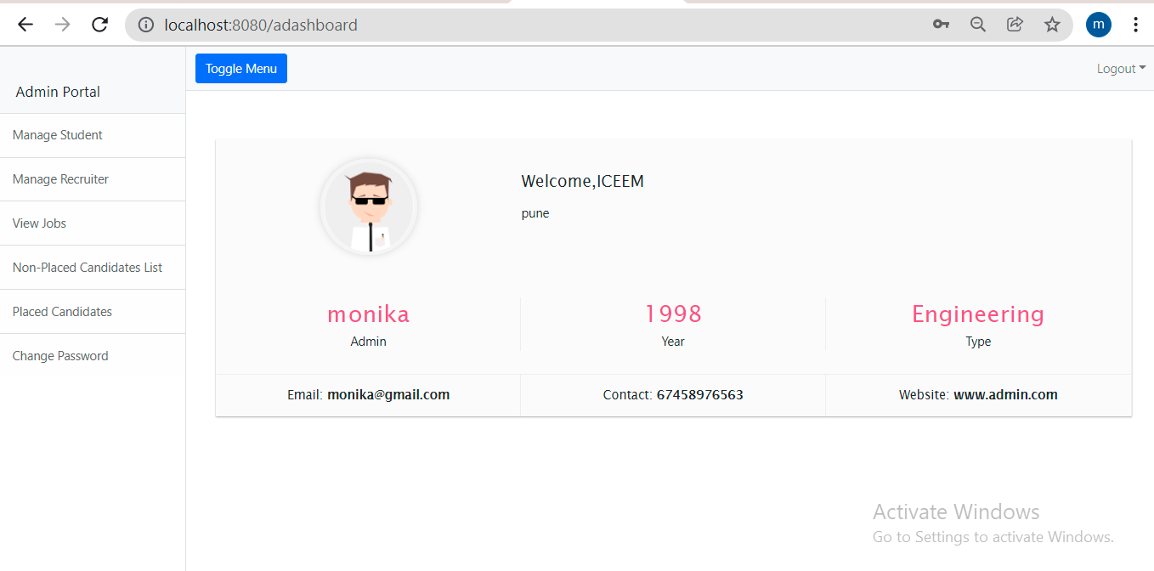
Admin dashboard:

Slide 12
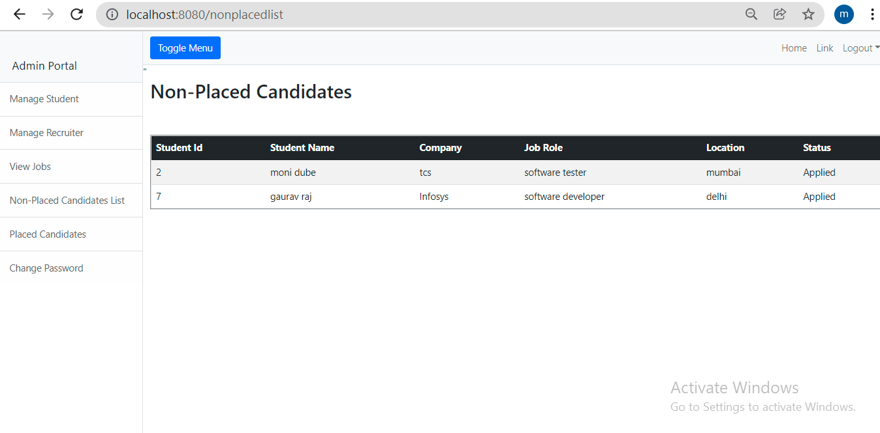
Non-Placed Student:

Slide 13
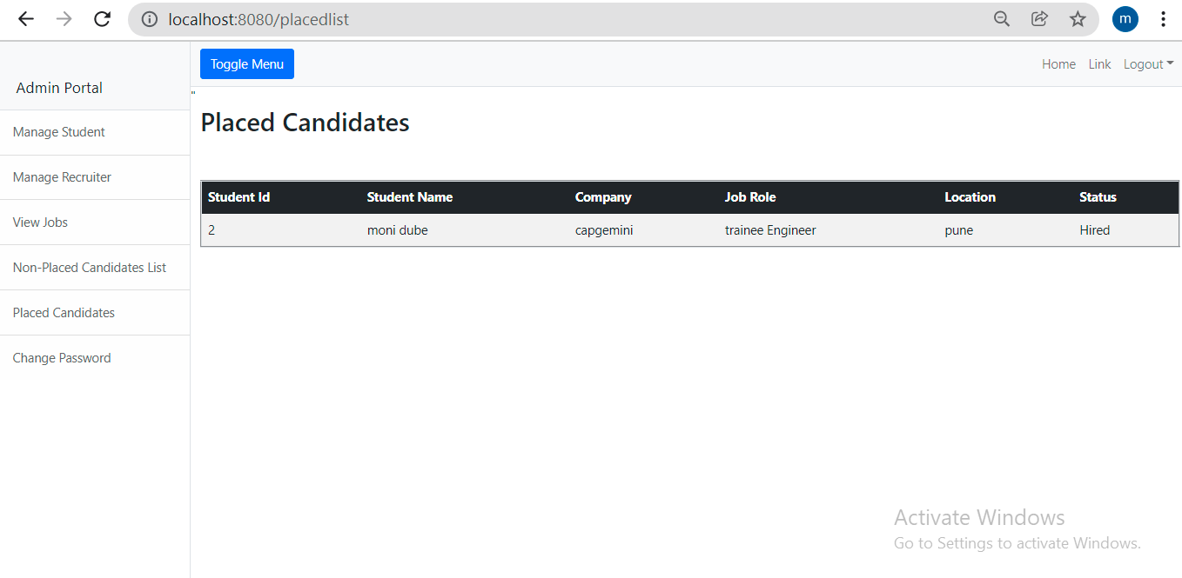
Placed student:

Slide 14
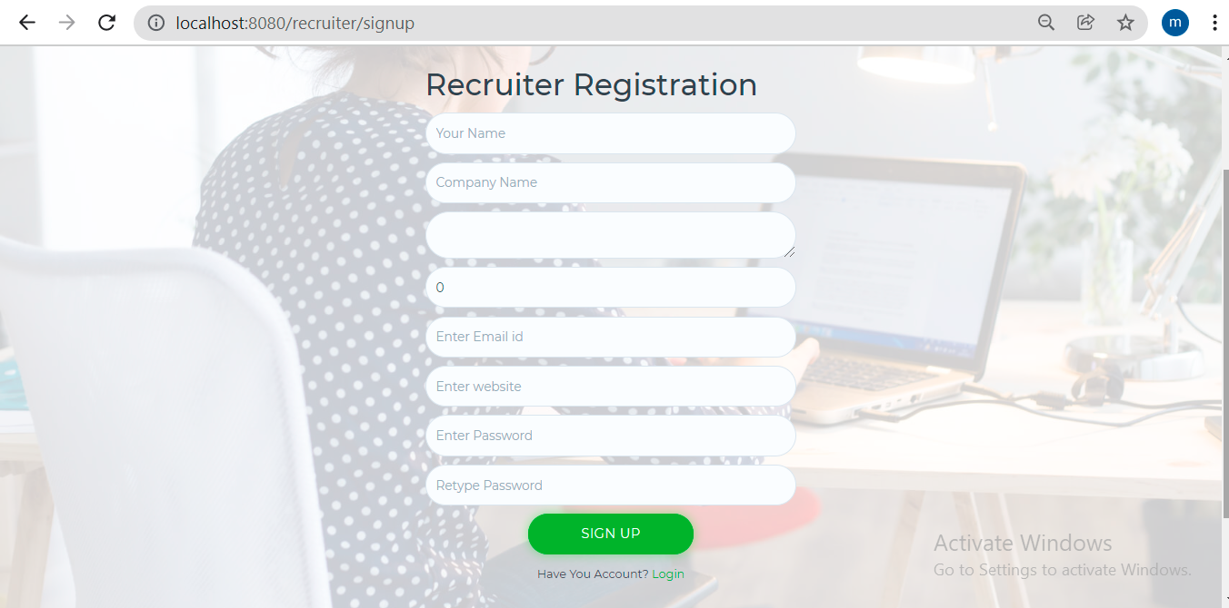
Recruiter Signup page:

Slide 15
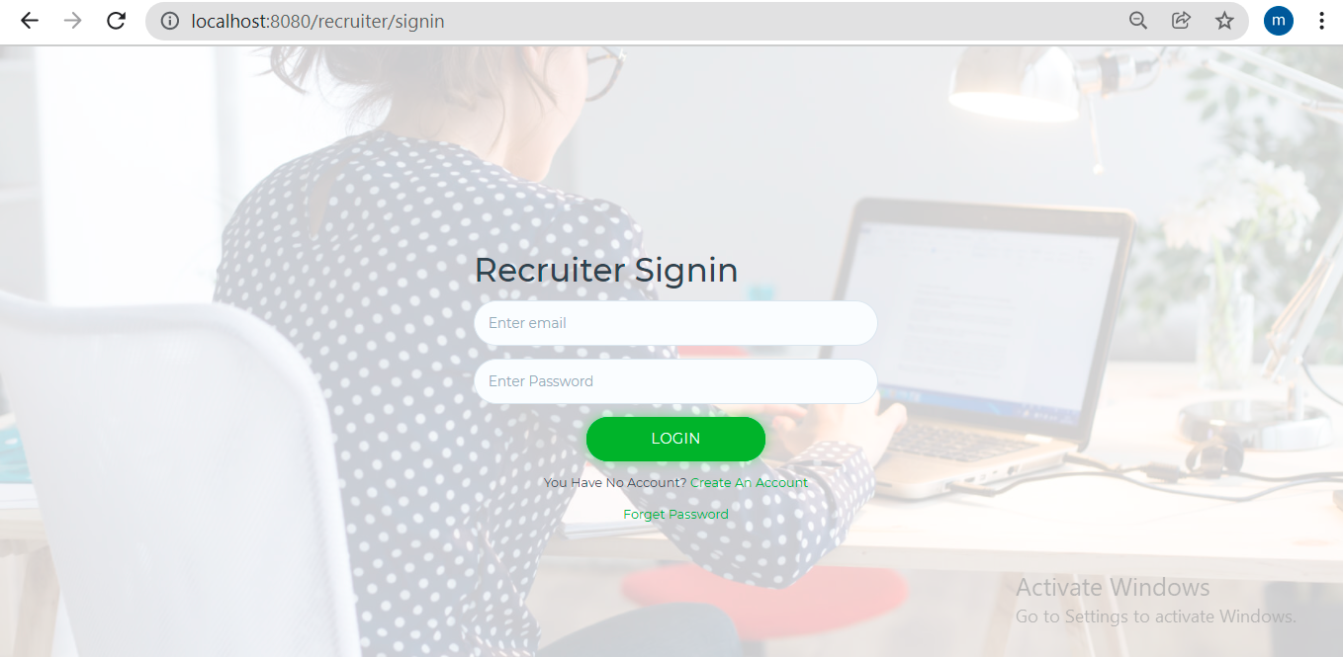
Recruiter Sign in page:

Slide 16
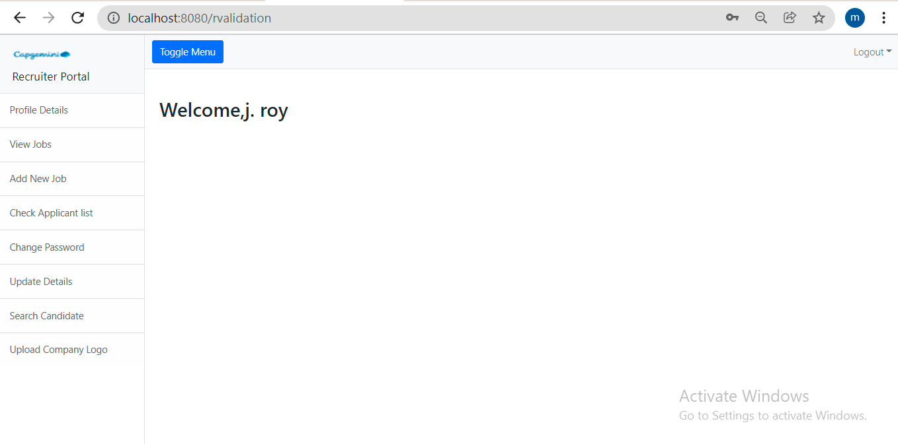
Recruiter Dashboard page:

Slide 17
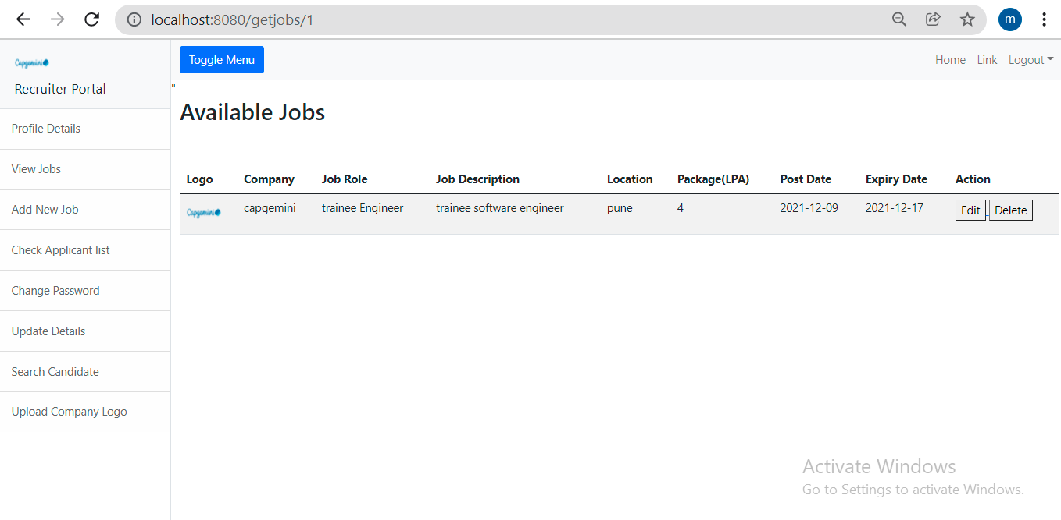
View jobs page:

Slide 18
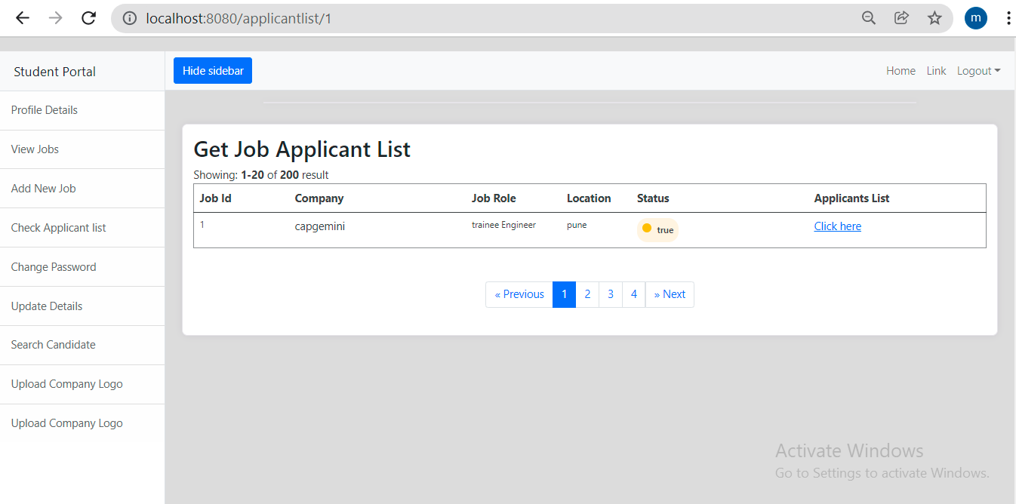
Check Applicant List page:

Slide 19
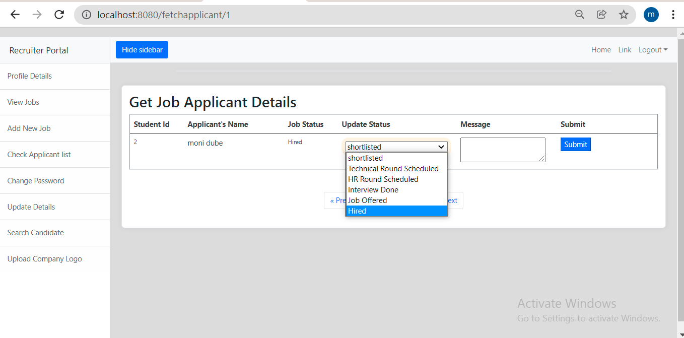
Applicant Details page:

Slide 20
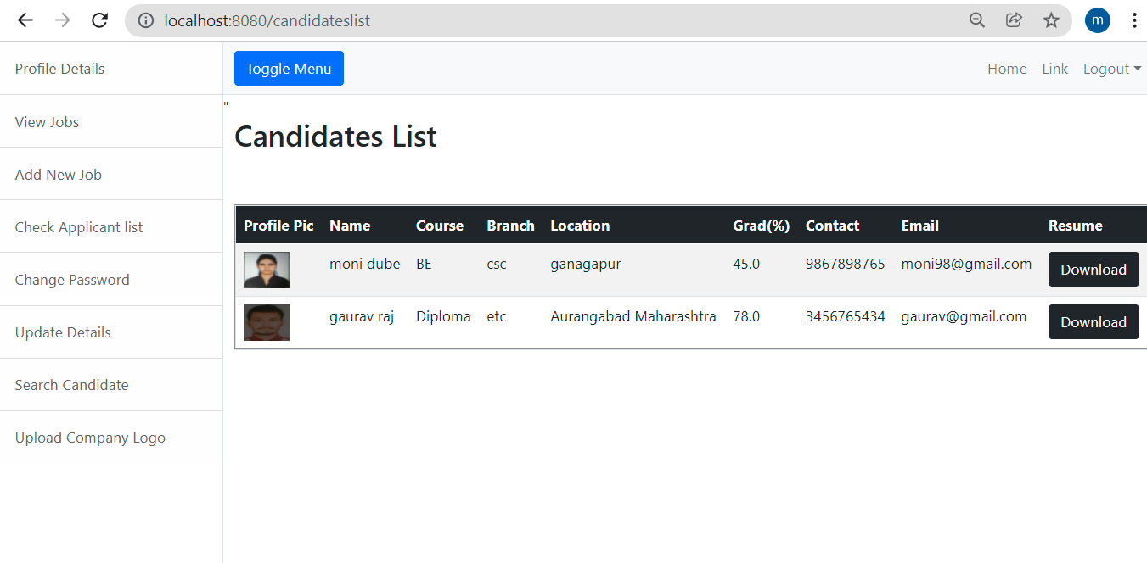
Search Candidates List page:

Slide 21
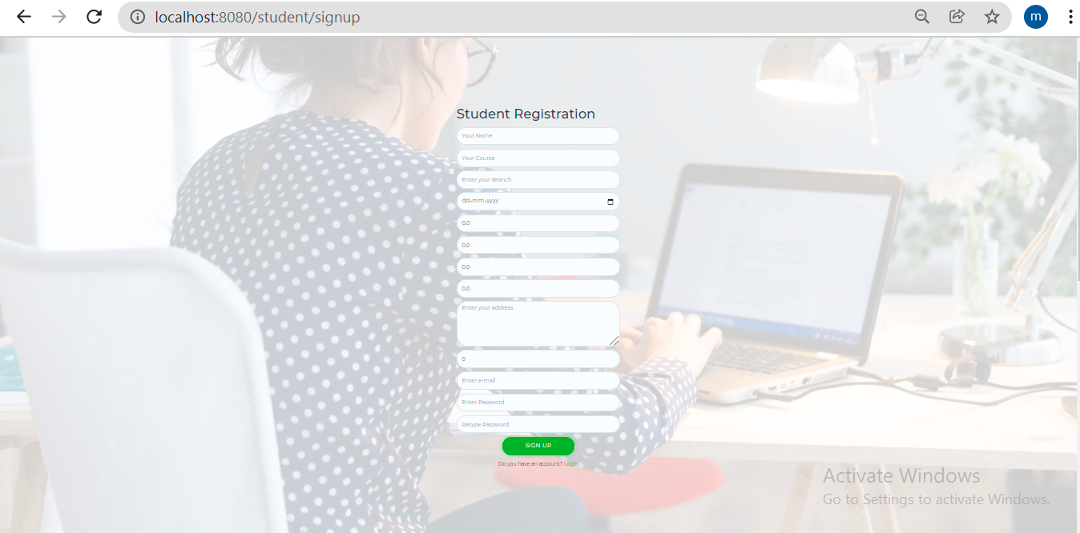
Student Signup page:

Slide 22
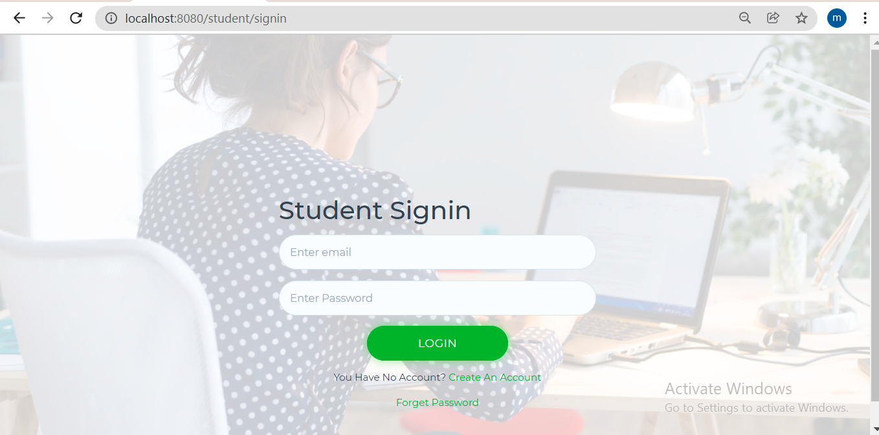
Student Sign in page:

Slide 23
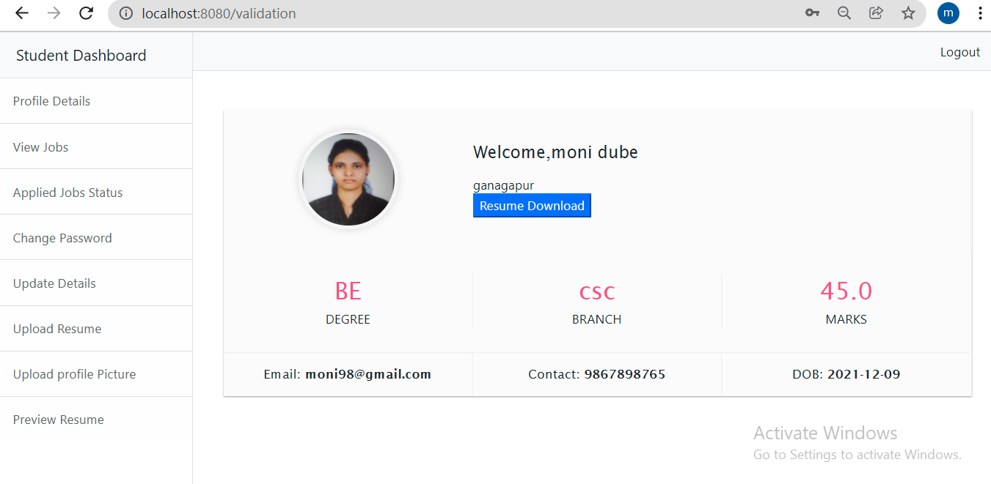
Student Dashboard page:

Slide 24
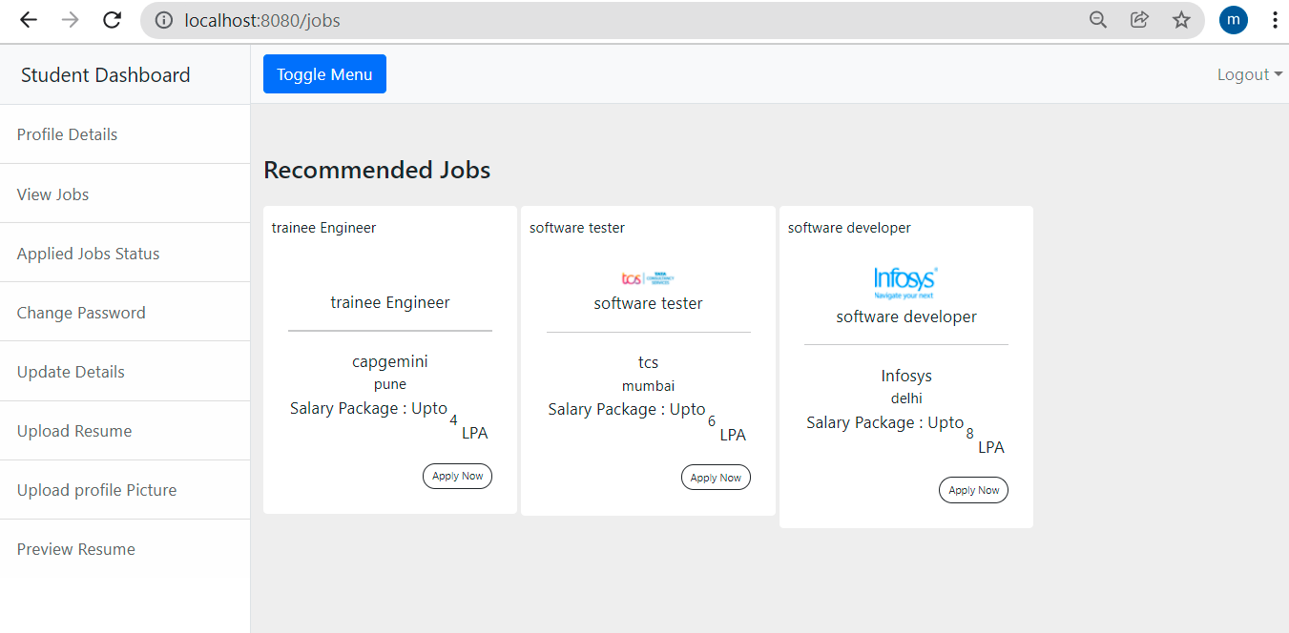
View jobs page:

Slide 25
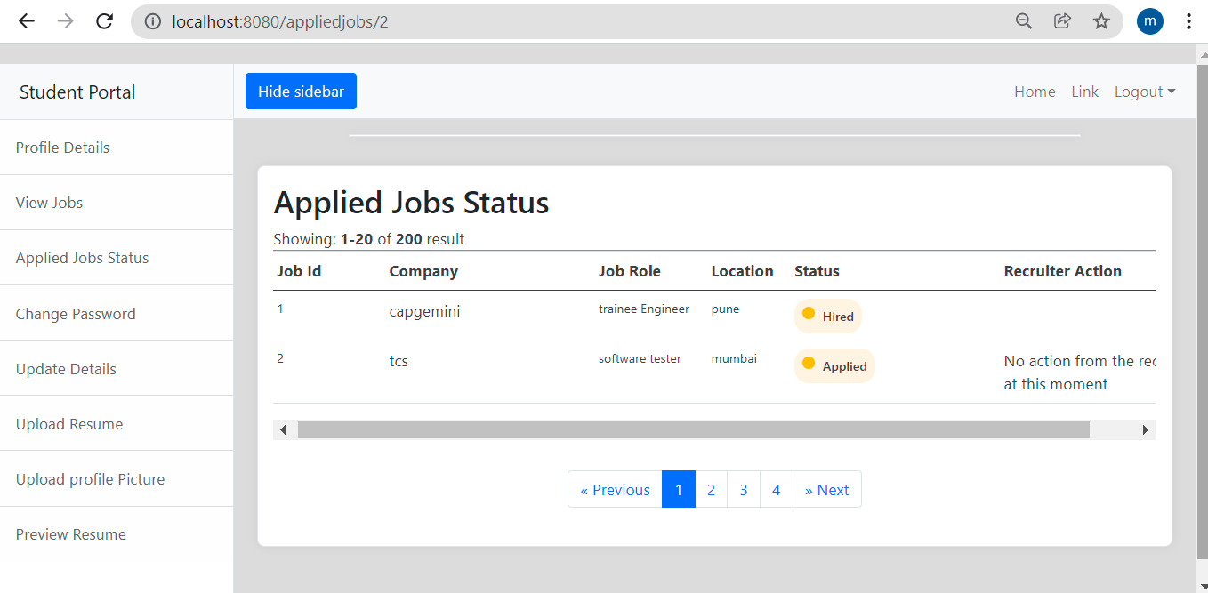
Applied Jobs Status:

Slide 26
Thank you

